Slide 1

IBM Data Science Capstone Project
Submitted by,
Rashmi

Slide 2
Background
A hypothetical tourism company named Personal Travel Guide (a startup) provides complete package for personalized travel plans (Travel, accommodation and food) to customers based on their very specific requirements.
It claims to provide the complete solution for the travel so that the customer need not to worry about anything during the travel and stay and can enjoy the tour at fullest.

Slide 3
Problem
The Sinhas have decided to go to New York for a five-day tour and they have approached Personal Travel Guide to plan their trip. They have mentioned few specific requirements for their trip based on which they want their trip planned-
5 day stay in New York
Hotel should be in the central location of the city from where all the main tourist points are nearby. Hotel should have good ratings, an excellent view and should have amenities such as swimming pool, breakfast on bed, TV and a refrigerator in room.
A detailed plan of every day itinerary including the tourist points to cover and famous eating joints around those points.
Famous night clubs and Indian restaurants near the Hotel.
Famous places to shop near the Hotel

Slide 4
Data Description
Following data will be required for this project:
List of Hotels in central New York, their ratings and reviews, amenities provided by them
List of famous tourist points and their distance from the list of hotels obtained in 1st point
After the finalization of hotel, list of night clubs and Indian restaurants near the hotel and their ratings and reviews
List of shopping places near the selected hotel and their ratings and reviews
The data for this project is taken from Foursquare API. The list of hotels, restaurants, tourist destinations and night clubs based on popularity and other requirements such as distance and user ratings can be extracted from foursquare.

Slide 5
Methodology
Hotel selection:
List of hotels in central New York (within 5 km radius) will be extracted from Foursquare.
Hotels with the required amenities (Breakfast on Bed, swimming pool, TV and refrigerator) will be filtered from the list
The filtered list of hotels will be checked against user reviews and the ones having ‘excellent/good view’ and an average rating greater than 4/5 will be selected
A list of most famous tourist points will be extracted from Foursquare and their distances from the list of hotels obtained will be calculated to get the hotel with minimum distance from all the selected tourist points for 5 days
List of tourist points to cover every day:
Obtain 40 most popular venues within 20 km radius of selected hotel
Perform Cluster analysis on these venues and divide them in 5 clusters based on distance from the hotel (5 clusters for 5 days)
Tourist points in each cluster will be covered each day of the 5 day stay
List of Indian restaurants, shopping places and night clubs near the hotel:
List of most famous Indian restaurants, shopping places and night clubs within 1 km radius of the hotel will be extracted from Foursquare and top 5 locations will be selected in each category based on user ratings and reviews.

Slide 6
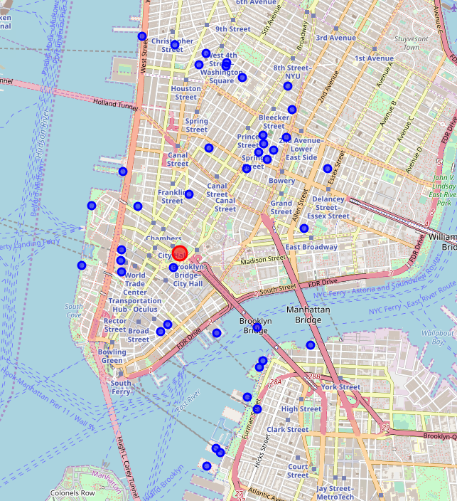
Result
Map of selected hotel and most popular venues around the hotel
Hotel – red circle
Nearby most popular venues – blue circles

Slide 7
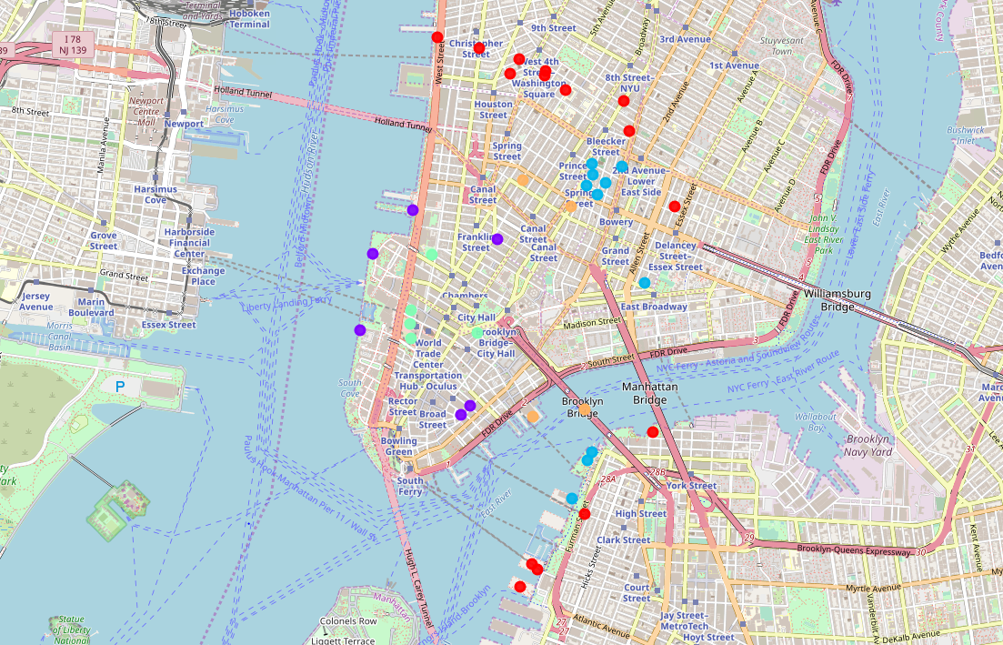
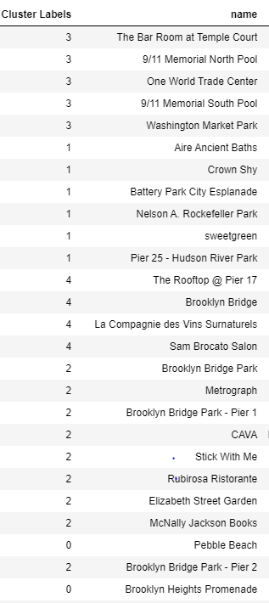
Result
Snapshot of cluster labels for venues

Slide 8
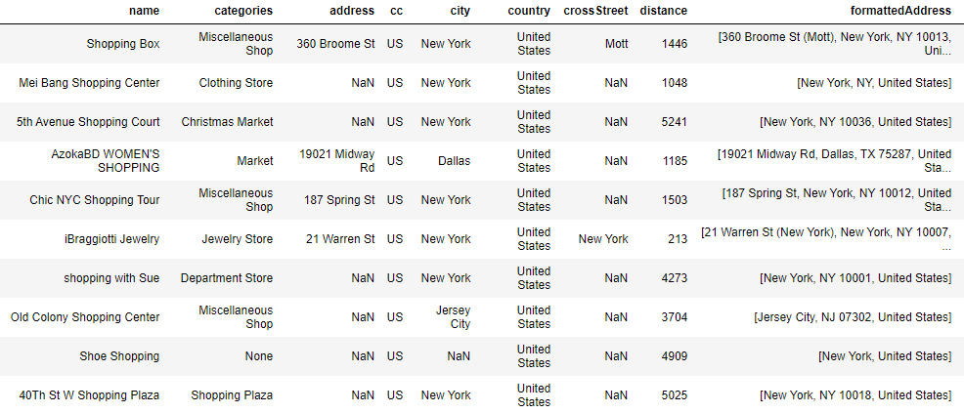
Result
Popular Shopping places near Hotel

Slide 9
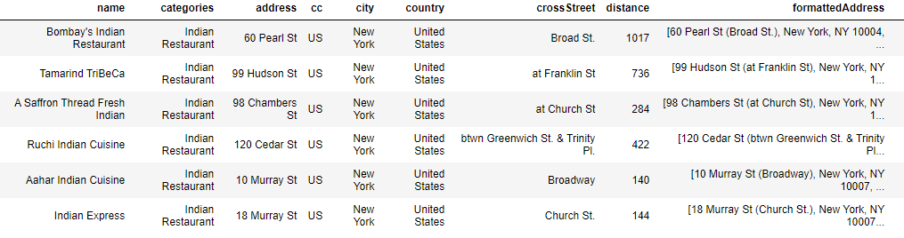
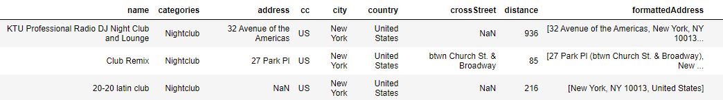
Result
Popular Indian
Restaurants near Hotel
Popular night clubs
Near Hotel

Slide 10

Thank You

